Slide 1


what is Selenium?

Slide 2


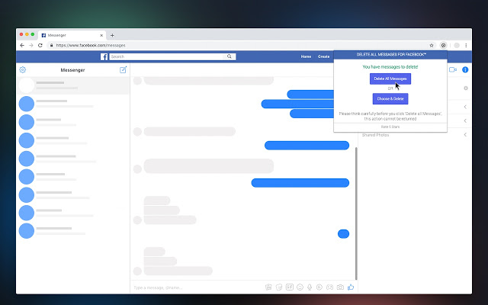
Testing
Verifying whether the Application is working properly or not is called Software testing

Slide 3
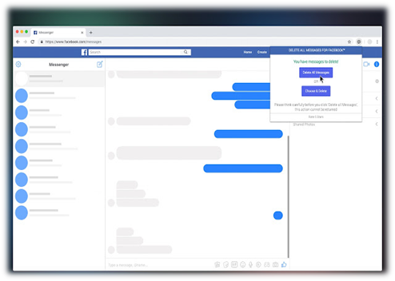


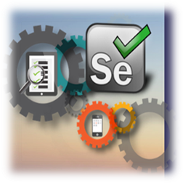


Testing
Testing the Application
Without Human Intervention via some tools
Testing the Application
With Human Intervention
Manual Testing
Automation Testing

Slide 4


What is ?
is an open Source Test Automation Tool for Testing Web Applications

Slide 5
Minimum Salary is 4 LPA in INDIA for Selenium Engineer
Selenium
QTP
Job market for selenium is too high when we compare it with QTP

Slide 6
Advantages of Selenium
Free and Open Source
  Cost of the Project is reduced
  It can be customized
Platform independent
  On Any OS it can be installed
Supports Multiple Languages
  Supports 14+ Languages
  When Programming language and Automation Language is same then developers can also help automation engineers
Supports multiple browsers

Slide 7
Dis-Advantages of Selenium
It Can Automate only Web Applications
OTP, Audio, Video, Captcha, Fingerprints cant be automated

